Slide 1
GENERATIVE AI & DOCUMENT INTELLIGENCE
StudyLens AI
Transforming static documents into interactive knowledge graphs using RAG.
github.com/tmthangaraj1980-AIML/Studylense_AI

Slide 2

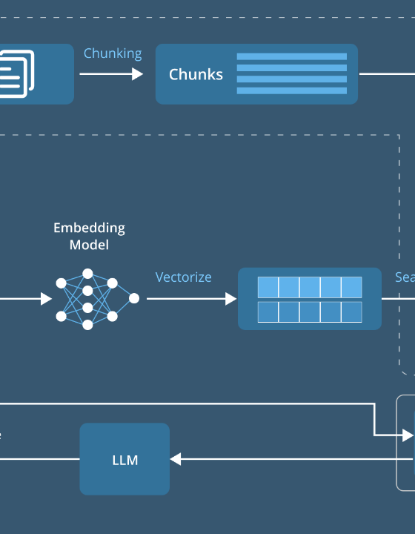
THE PROBLEM
Information Silos
Data Overload: Massive volume of unstructured enterprise PDFs.
Retrieval Friction: Keyword search fails contextual intent.
Static Context: Inability to cross-reference multiple dense sources.

Slide 3



Core Objectives
Semantic Ingestion
Instant Retrieval
Grounded Generation
Parse complex layouts accurately.
Sub-second vector similarity search.
Zero-hallucination factual synthesis.

Slide 4






Technology Stack
Python 3.10
FastAPI
LangChain
ChromaDB
OpenAI / LLMs
PyPDF2

Slide 5
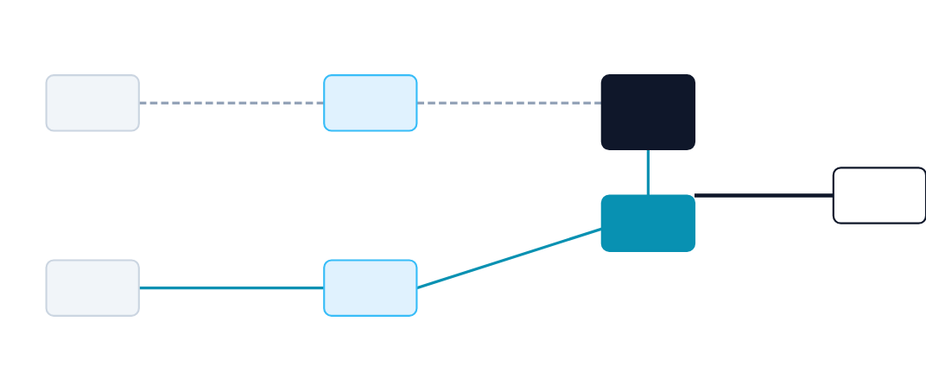
RAG Architecture
PDF Docs
Embeddings
Vector
Database
Response
LLM
User Query
Query
Embedding

Slide 6
Processing Pipeline
1
2
3
4
Ingestion
Chunking
Vectorizing
Synthesis
Parse raw PDF text.
Recursive character splitting.
Generate dense embeddings.
LLM generates answer.

Slide 7
Dataset & Preprocessing
Source Material
Cleaning Pipeline
Academic research papers.
Whitespace normalization.
Corporate technical manuals.
Non-ASCII character removal.
Unstructured text corpora.
Semantic chunking strategies.

Slide 8
Core AI Algorithms
Dual-model architecture powering the intelligence engine.
Embedding Model
Generation LLM
Model: OpenAI text-embedding-ada-002
Model: GPT-3.5-Turbo / GPT-4
Function: Maps text chunks to 1536-dimensional vectors.
Function: Synthesizes answers bounded by retrieved context.

Slide 9

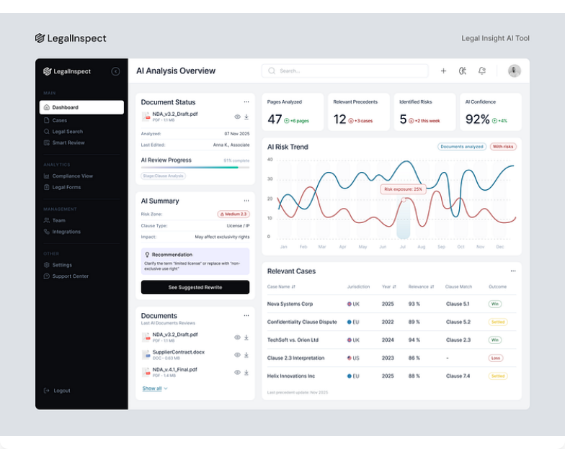
Application Interface
Clean, intuitive chat interface facilitating real-time document interrogation.
Live Status: Deployed

Slide 10
Challenges & Iterations
Encountered Challenges
Future Improvements
Context Window Limits Truncated large document retrieval results.
Multimodal RAG Process images and diagrams alongside text.
Table Extraction Loss of structural format in standard PDF parsers.
Hybrid Search Combine keyword (BM25) with vector search.

Slide 11
Technical Q&A
1. How does RAG mitigate hallucination?
4. How to optimize Vector DB speed?
Grounds the LLM generation explicitly in retrieved factual context.
Utilize HNSW (Hierarchical Navigable Small World) indexing.
2. Why semantic over lexical search?
5. Handling massive documents?
Captures contextual meaning rather than exact keyword matches.
Implement map-reduce summarization prior to querying.
3. Ideal chunking strategy?
Recursive character splitting with overlapping windows.

Slide 12

Intelligent Insights Delivered.
StudyLens AI bridges the gap between static enterprise data and actionable knowledge extraction.
/Studylense_AI
tmthangaraj1980

Slide 13


Image Sources
https://d3lkc3n5th01x7.cloudfront.net/wp-content/uploads/2024/08/26051537/Advanced-RAG.png
Source: www.leewayhertz.com
https://cdn.dribbble.com/userupload/45788503/file/b1676f6d71c218be5825d216432d1398.png?resize=752x&vertical=center
Source: dribbble.com

